Slide 1

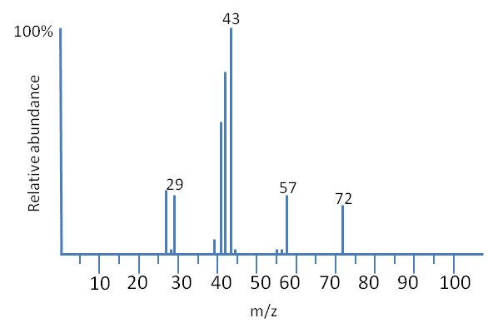
TUMOR HETEROGENEITY Represented To: Dr/ Ahmed Morsy
Team Members:
Mostafa Yehia Donia Abd Elslam
Renad Taher Mariem Ahmed
Ibrahim Elsayed

Slide 2

Today’s Agenda
01 INTRODUCTION
02 TECHNIQUES
03 INSTRUMENT
04 PCA
05 t-SNE

Slide 3
INTRODUCTION

Slide 4

01: Mass Spectrometry-based Proteomics
METHODS
2-D gel
Liquid Chromatography
Capillary Electrophoresis
Molecular scanner gels
Capillary-Isoelectric Focusing
This universal technique analyzes complex protein samples.
It’s applied following isolation of the proteins from cell lysates by:
Biochemical Fractionation
Affinity Selection
Notes:
Notes to presenter:
What is your purpose for sharing this reflection?
Is it at the end of a unit or project?
Are you sharing this reflection, at the attainment of a learning goal you set for yourself?
Is it at the end of a course?
State your purpose for the reflection or even the purpose of the learning experience or learning goal. Be clear and be specific in stating your purpose.

Slide 5
TECHNIQUES

Slide 6

02: How The Spatial Information is Obtained?
MICROPROBE
The most common and the simplest technique.
MICROSCOPE
Microscope mode imaging uses ion-optical microscope elements to project the spatial origin of the ions onto a position-sensitive detector.
It can be described as position-correlated mass spectrometry.
It’s described in MALDI literature as Imaging Spectrometry Imaging (IMS).
It has a finite depth of vision, which makes sample preparation more critical.
Notes:
Notes to presenter:
Description of what you learned in your own words on one side.
Include information about the topic
Details about the topic will also be helpful here.
Tell the story of your learning experience. Just like a story there should always be a beginning, middle and an end.
On the other side, you can add a graphic that provides evidence of what you learned.
Feel free to use more than one slide to reflect upon your process. It also helps to add some video of your process.

Slide 7
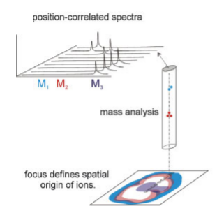
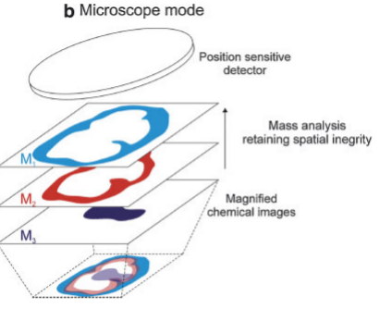

MICROPROBE vs MICROSCOPE
A focused ionization beam is used to analyze a small, localized region of the sample.
Spatial information is obtained from within the ionization spot.
Figure Above: Microprobe mode imaging records mass spectra from an array of designated positions to construct a molecular image.
Figure Above: Magnified images of mass resolved ion distributions are recorded with a 2D detector.
Notes:
Notes to presenter:
What did you think at first?
What obstacles did you encounter along the way?
How did you overcome those obstacles?
What images can you add to support your process?
This SmartArt allows you add images and text to help outline your process. If a picture is worth a thousand words, then pictures and words should help you communicate this reflection on learning perfectly! You can always click on Insert>SmartArt to change this graphic or select the graphic and click on the Design contextual menu to change the colors.
Feel free to use more than one slide to reflect upon your process. It also helps to add some video of your process.

Slide 8
INSTRUMENT

Slide 9

03: INSTRUMENT – Ionization Mechanisms
Matrix-Assisted Laser Desorption/Ionization – (MALDI)
4
MALDI can record the spatial distribution of high mass molecules using the chemically specific molecular ions
It’s spatial resolutions are approximately 25 mm or more
3
2
Secondary Ion Mass Spectrometry – (SIMS)
1
SIMS is able to provide high spatial resolution images
It’s molecular ion mass range is much lower than that of MALDI
Notes:
Notes to presenter:
What steps will you be taking as a result of this learning experience?
Did you learn from any failed experiences? How will you do things differently?
What advice will you give to others so they can learn from your experiences?
How can you share what you learned with a real-world audience?
Some examples of next steps might be:
After delivering my first persuasive presentation, I am thinking about joining the debate team.
After making my first film, I’m considering entering it in our school film festival or local film festival.
After connecting with this career expert, I’d like to do some research on that career field because it sounds interesting to me.
This SmartArt allows you add images and text to help outline your process. If a picture is worth a thousand words, then pictures and words should help you communicate this reflection on learning perfectly! You can always click on Insert>SmartArt to change this graphic or select the graphic and click on the Design contextual menu to change the colors.
Feel free to use more than one slide to share your next steps. It also helps to add some video content to explain your message.

Slide 10
Dimensionality Reduction

Slide 11
1. Principal Component Analysis (PCA)

Slide 12

03: PCA
Principal Component Analysis (PCA) is a linear dimensionality reduction technique that can be utilized for extracting information from a high-dimensional space by projecting it into a lower dimensional sub-space
Applied in Data visualization
Note:
Dimensionality reduction, or dimension reduction, is the transformation of data from a high-dimensional space into a low-dimensional space so that the low-dimensional representation retains some meaningful properties of the original data, ideally close to its intrinsic dimension

Slide 13
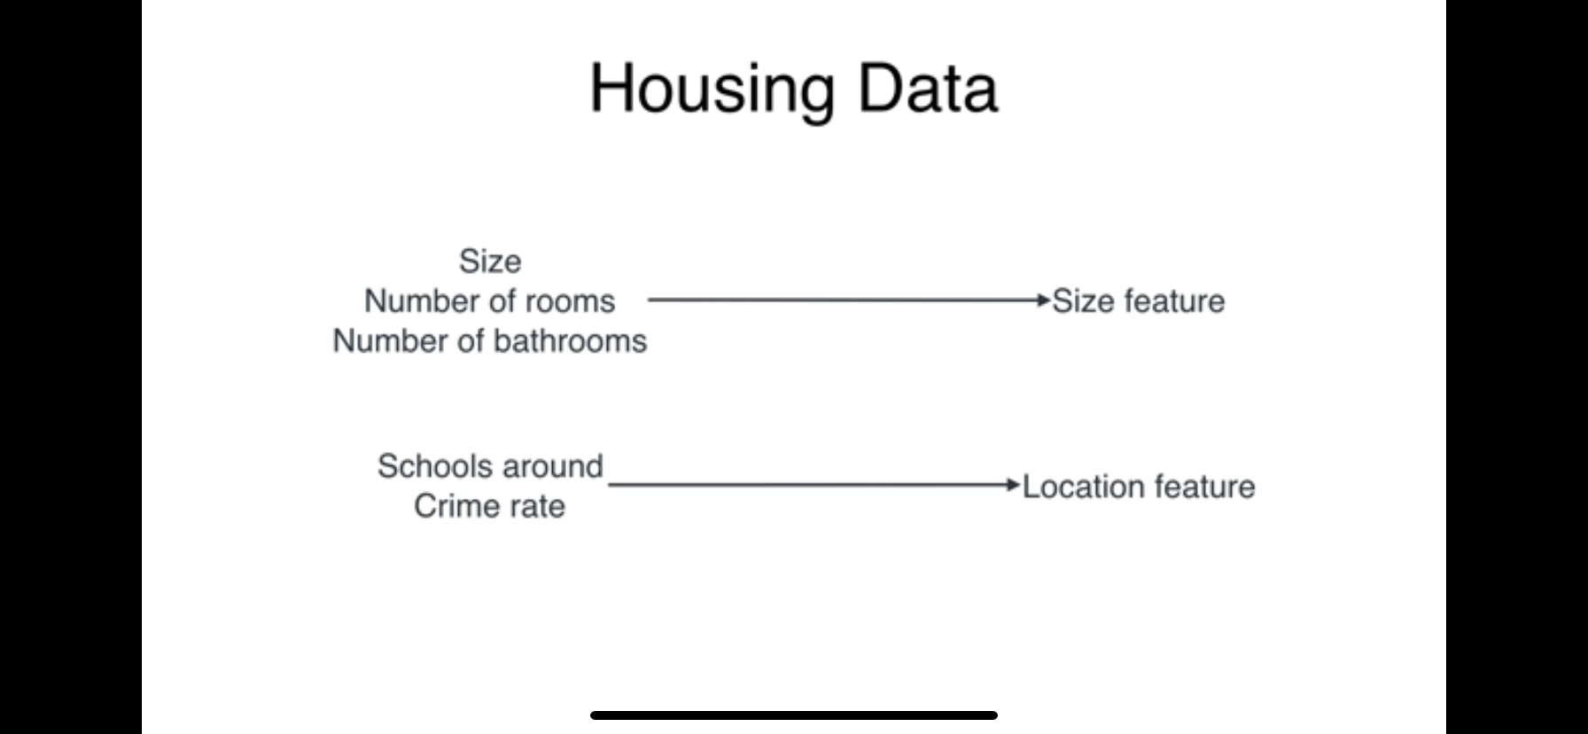
Example1 - Housing Data
Housing Data:
Size
Number of rooms
Number of bathrooms
Schools around
Crime Rate

Slide 14
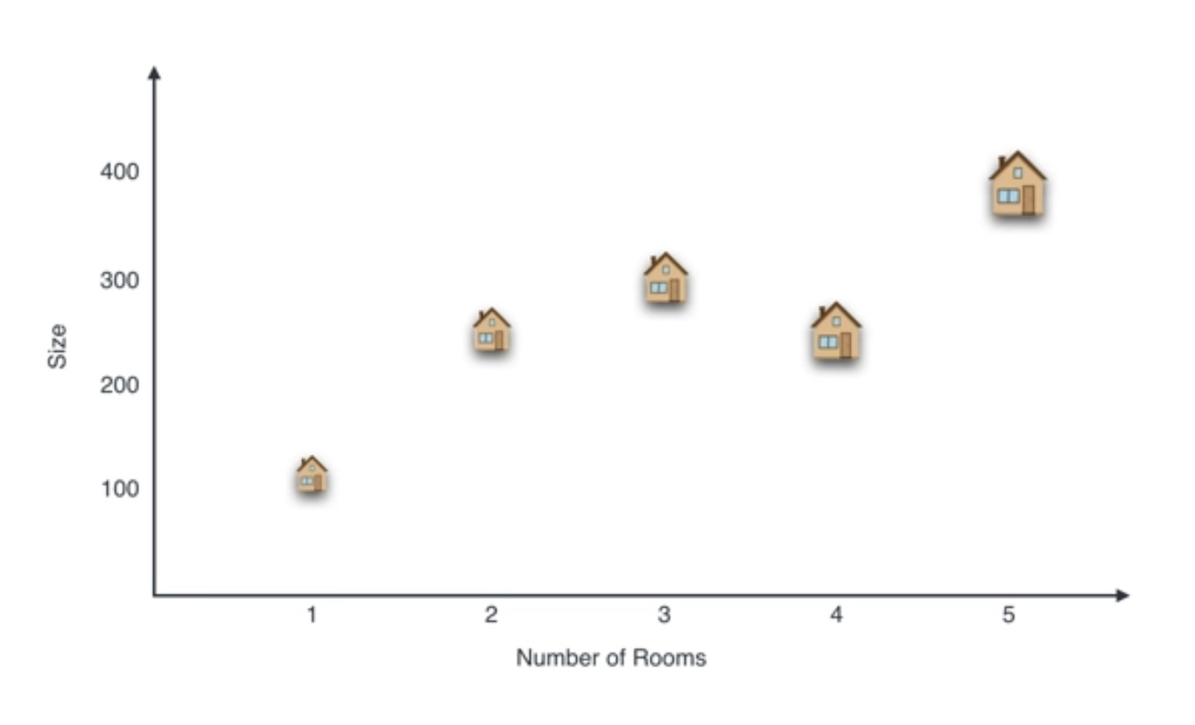

Slide 15
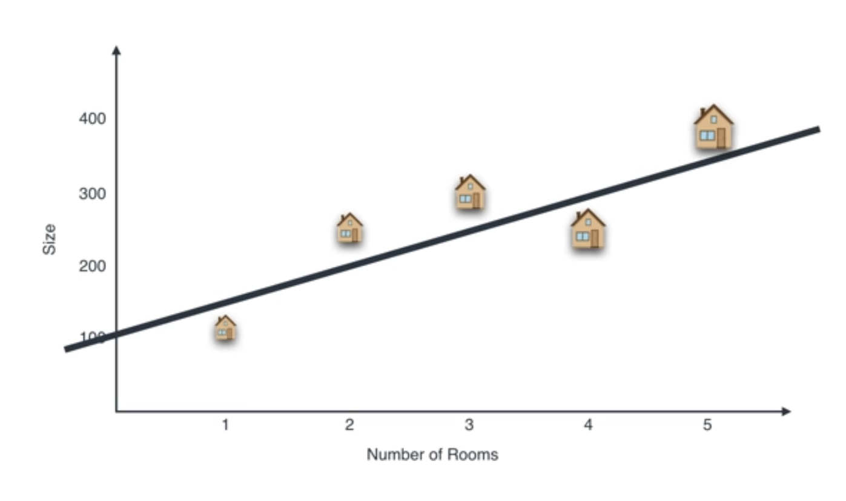

Slide 16
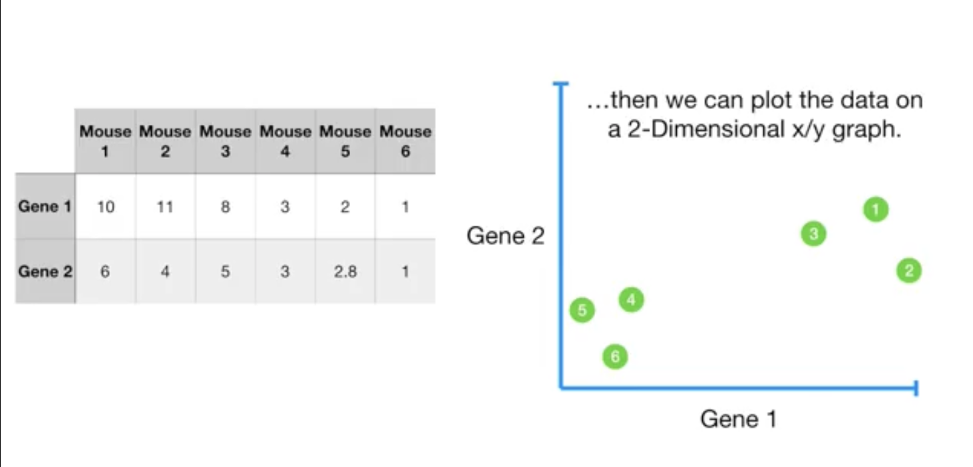
Example2 – Mouse Genes

Slide 17
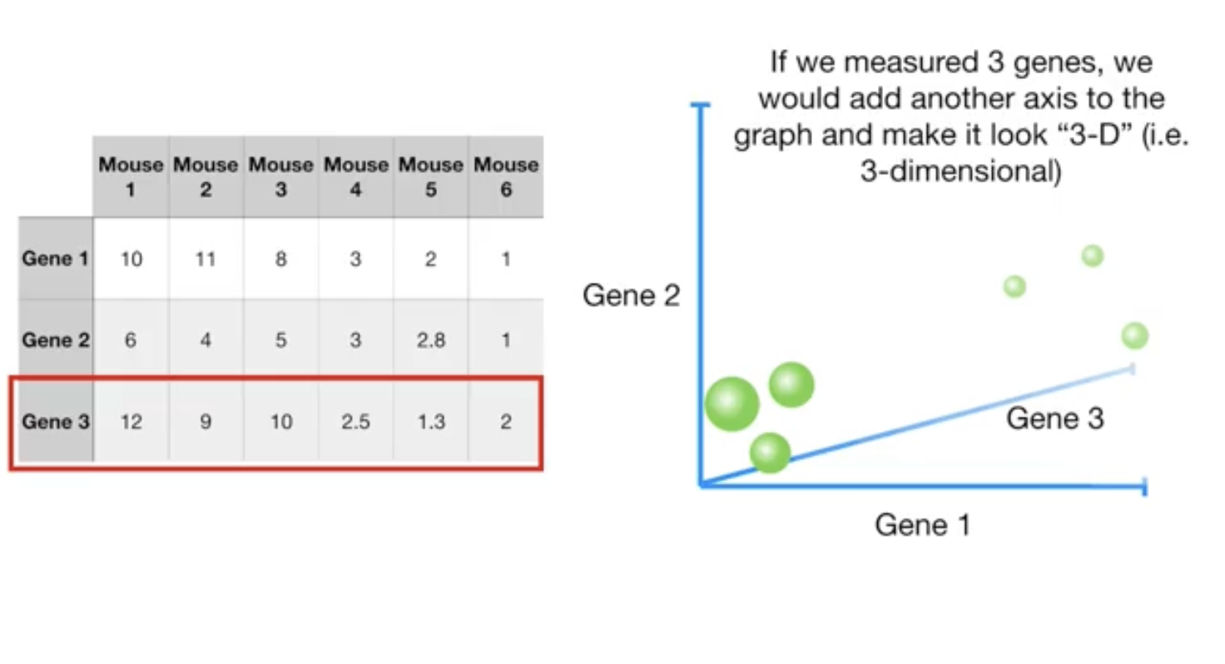

Slide 18
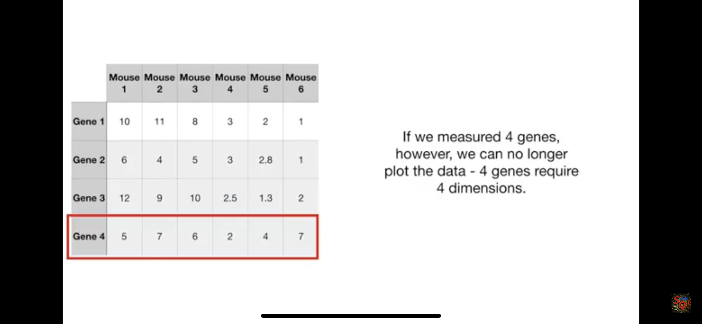

Slide 19
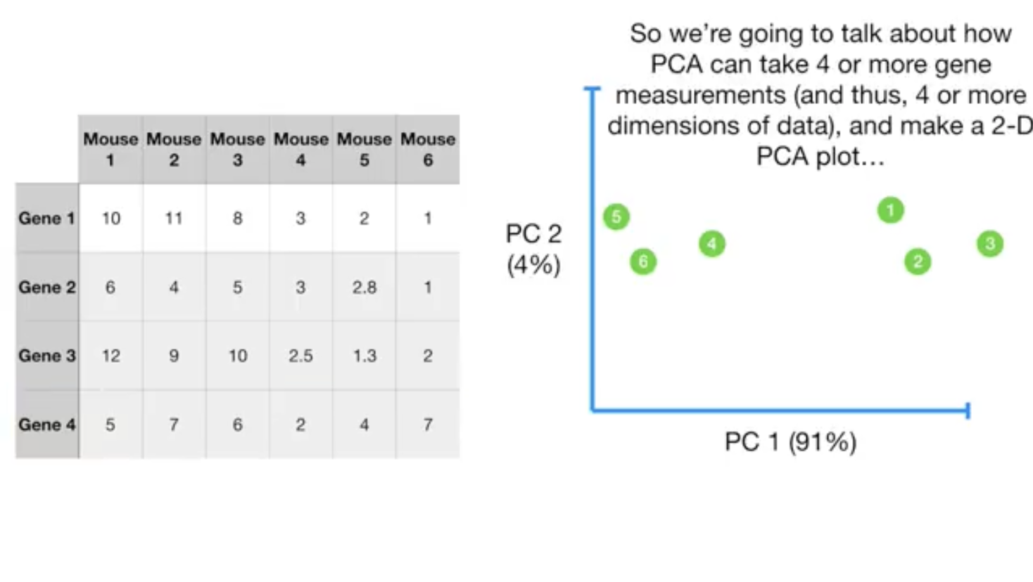

Slide 20
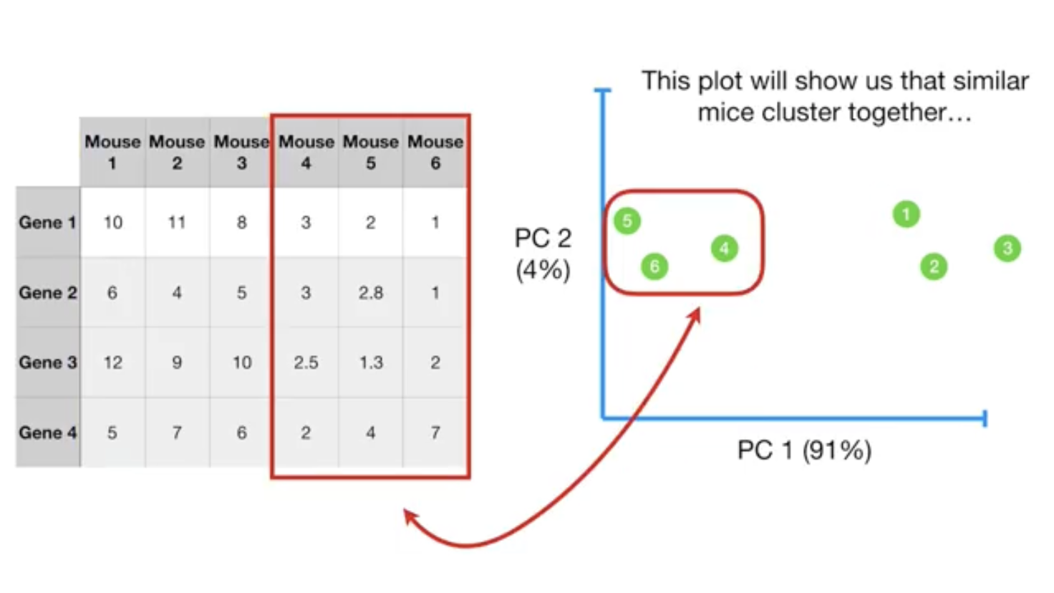

Slide 21
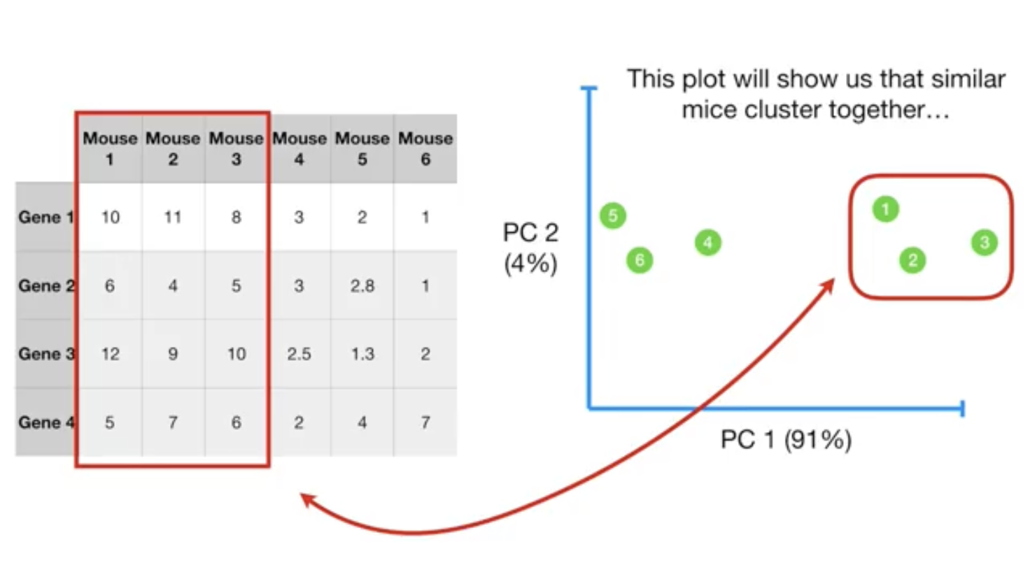

Slide 22
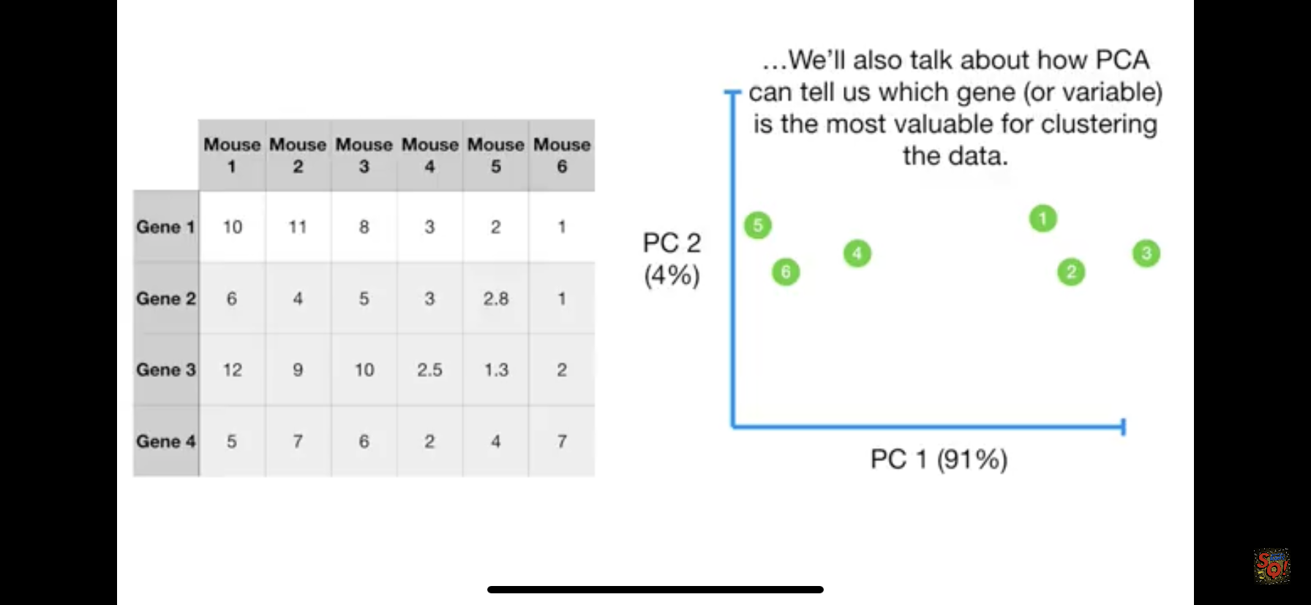

Slide 23
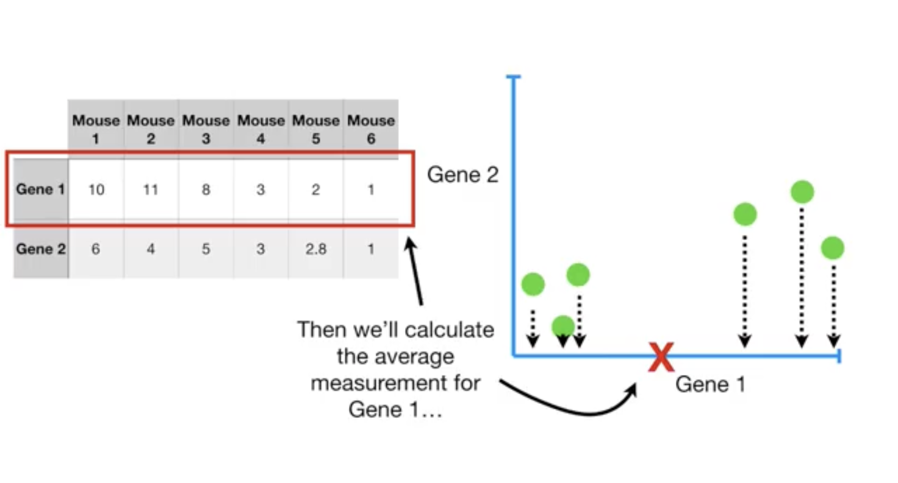

Slide 24
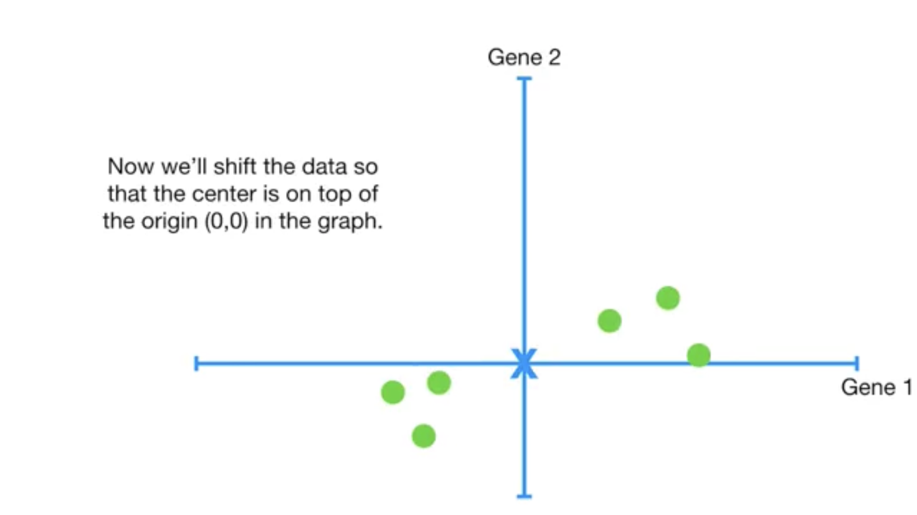

Slide 25
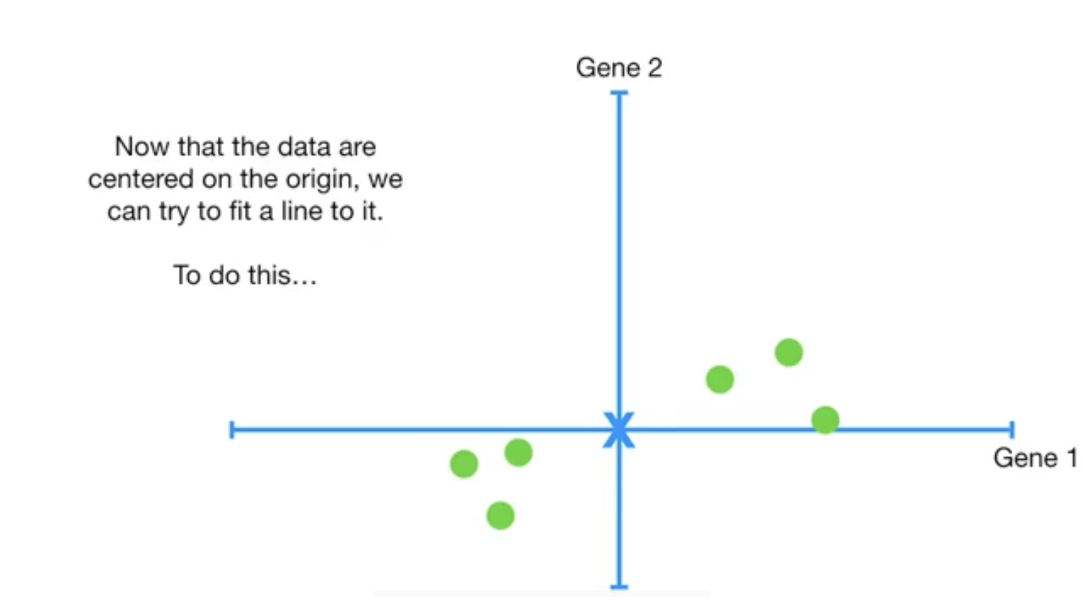

Slide 26
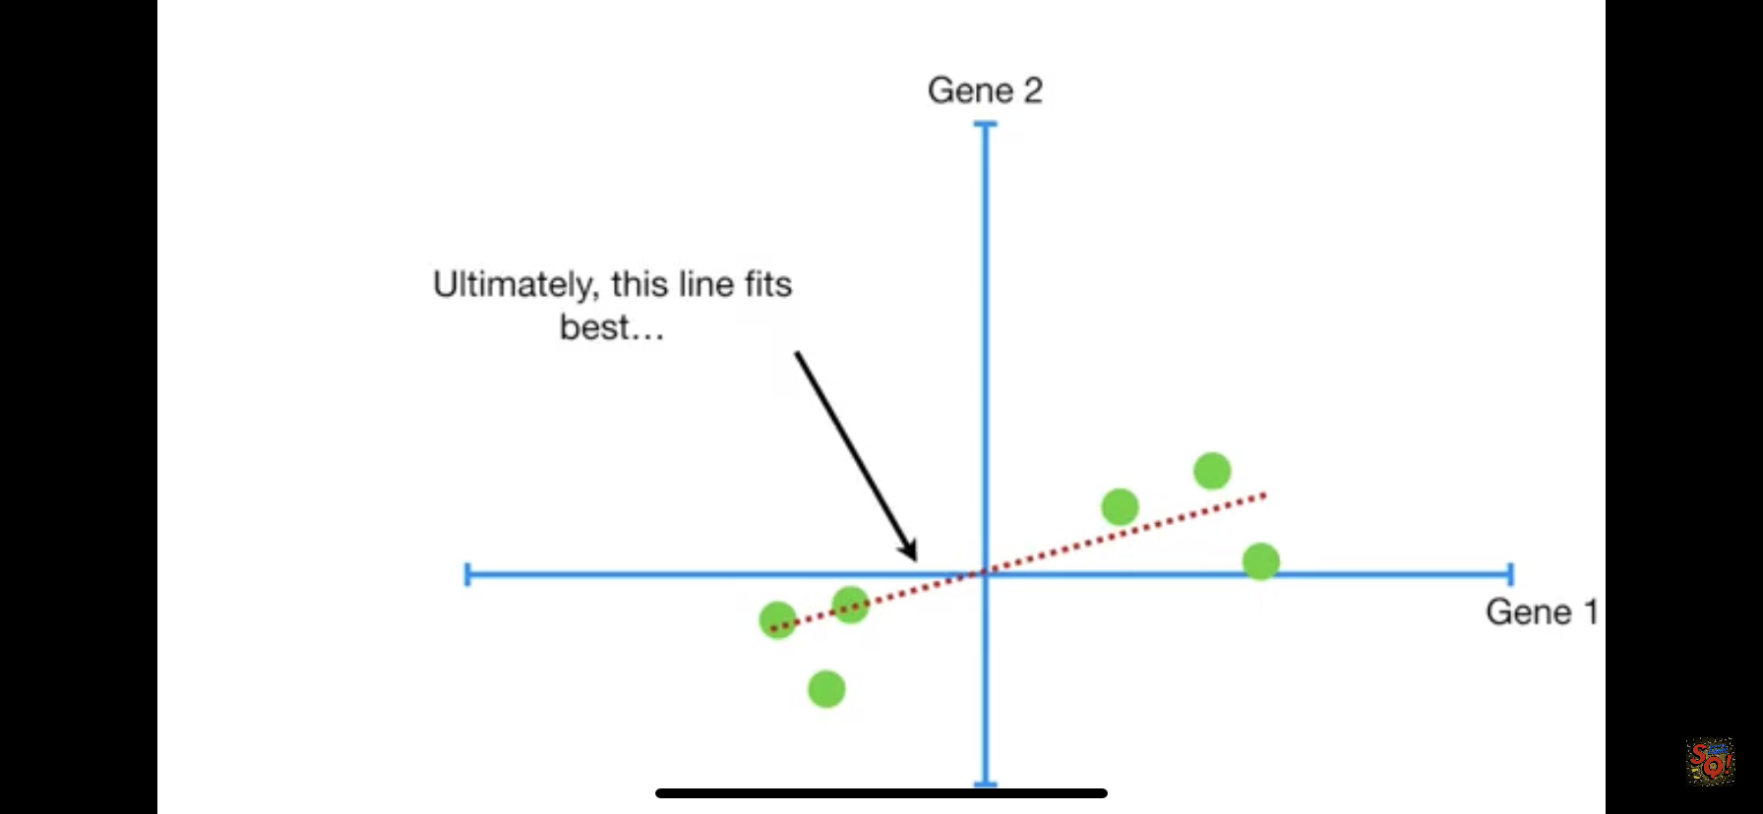

Slide 27
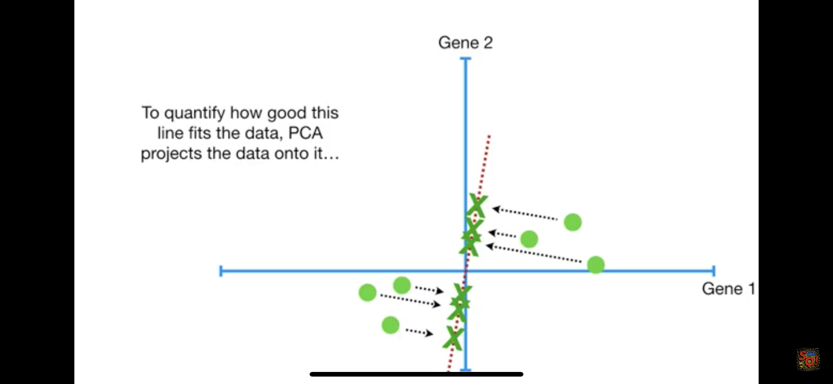

Slide 28
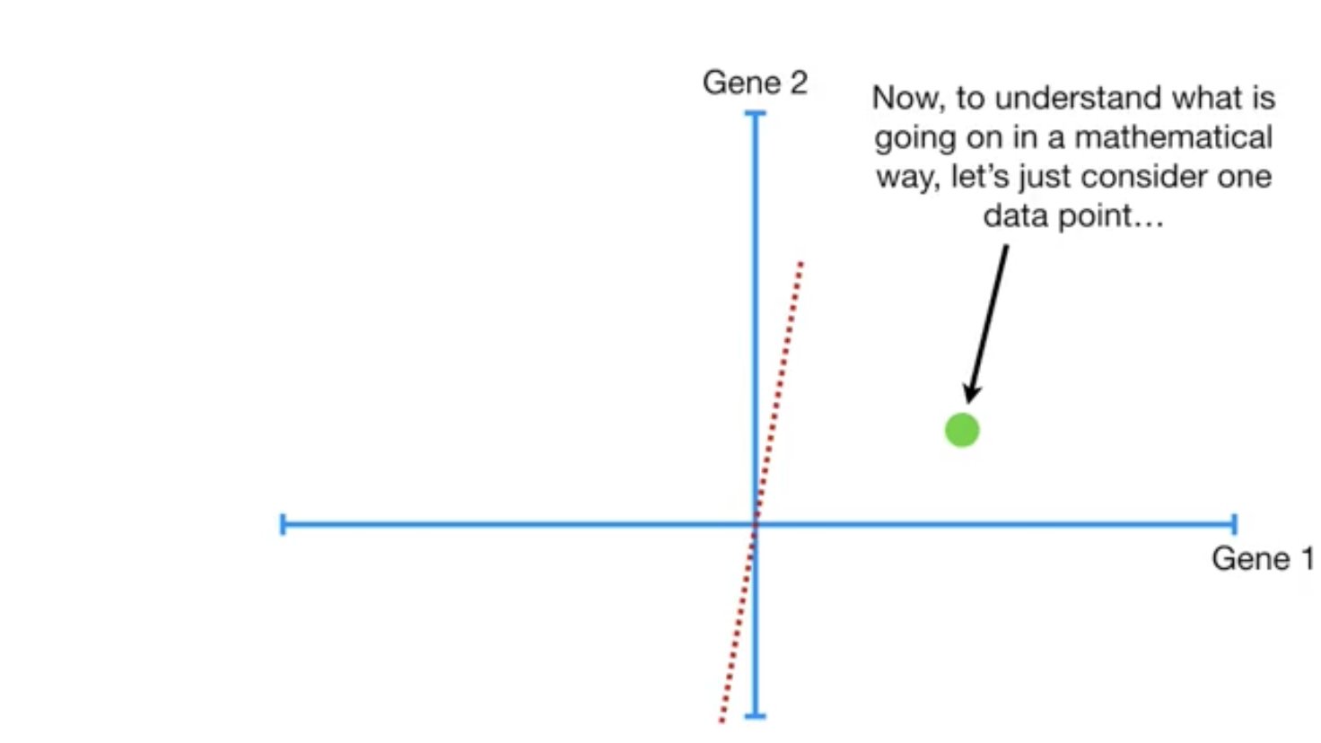

Slide 29
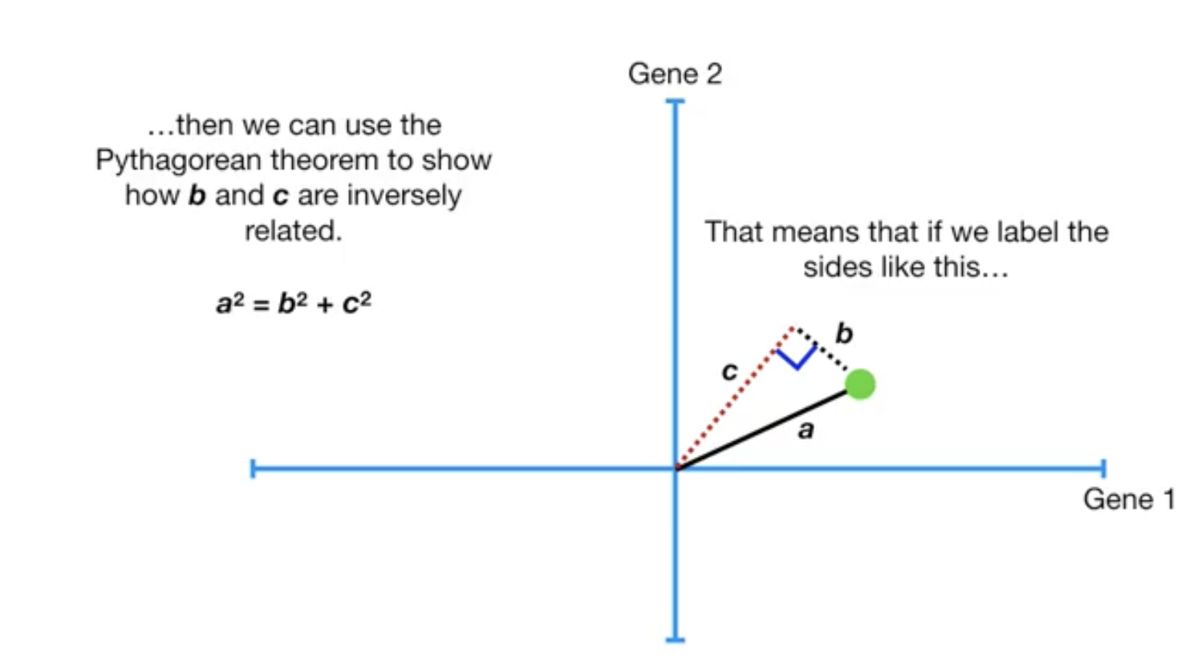

Slide 30
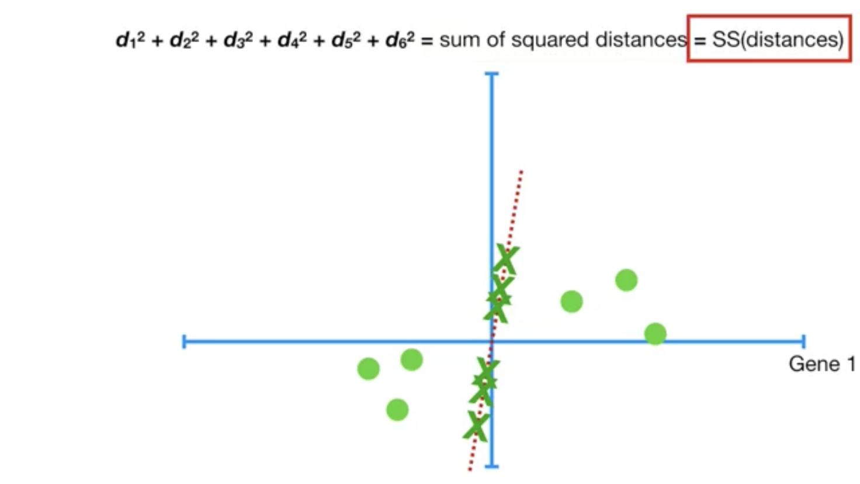

Slide 31
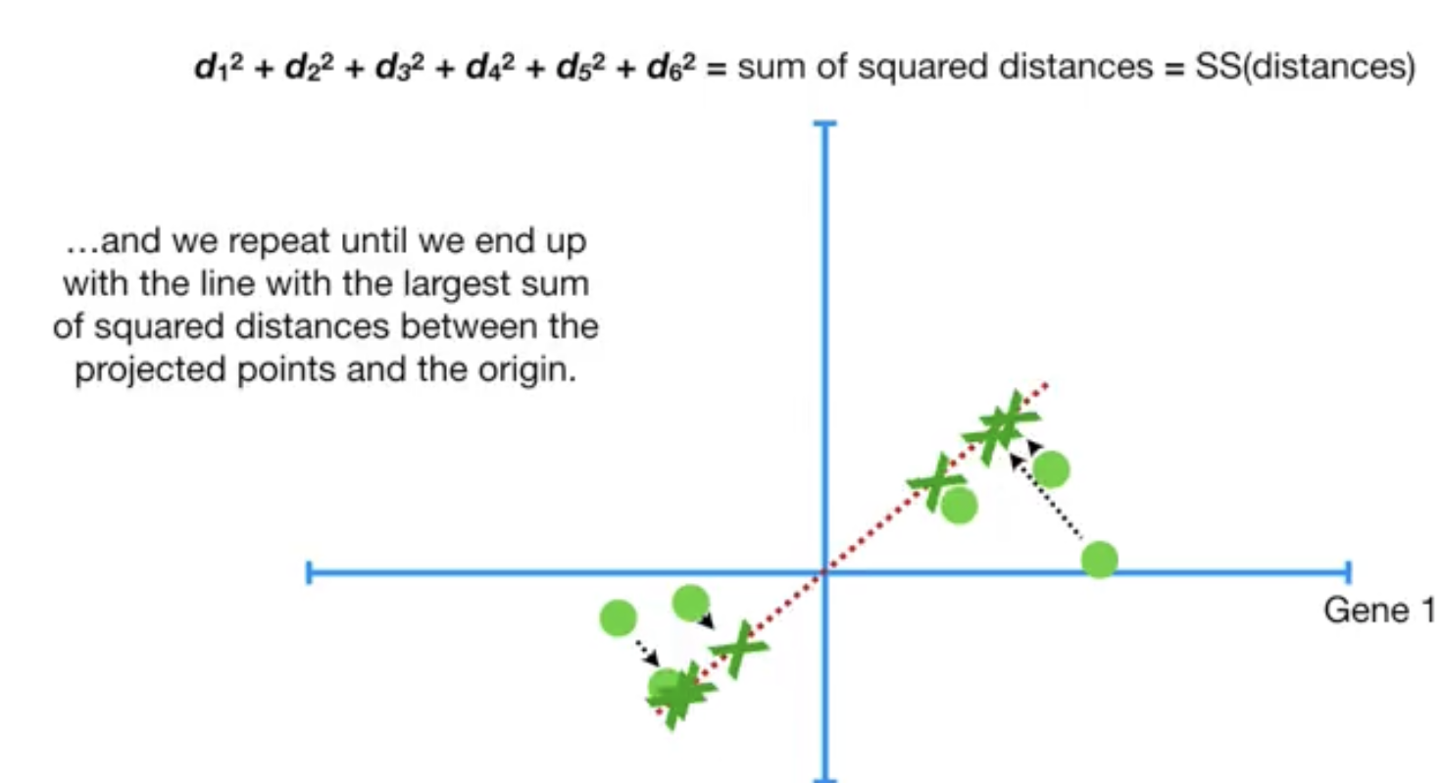

Slide 32
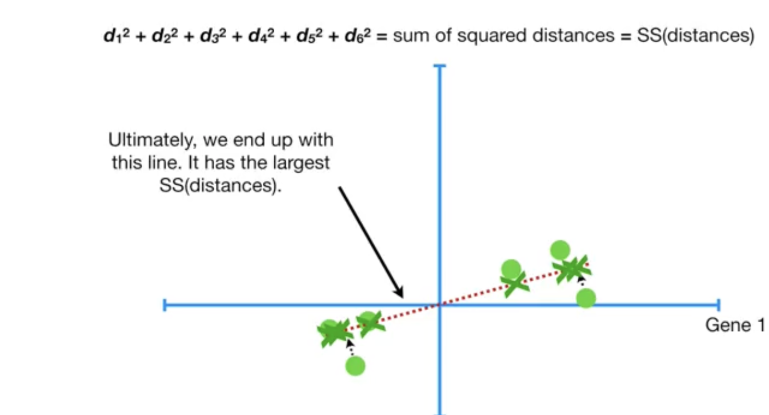

Slide 33
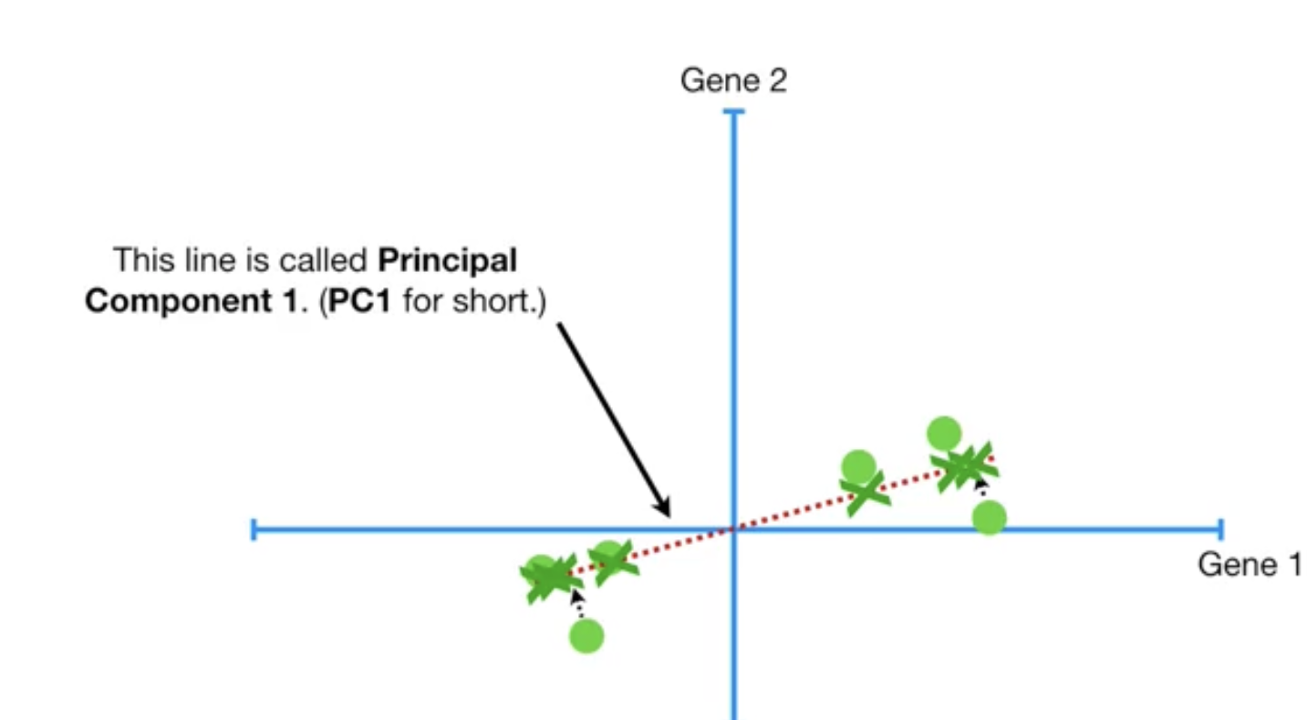

Slide 34
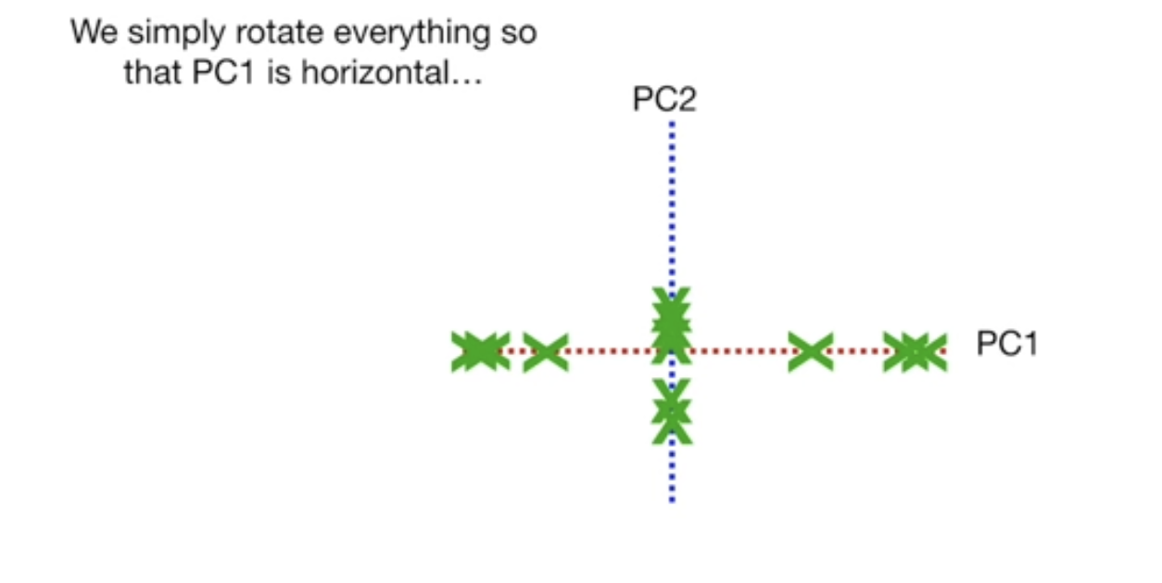

Slide 35
2. t-distributed Stochastic Neighbor Embedding (t-SNE)

Slide 36
Overview, Objective and Motivation
t-SNE is a dimension reduction/data visualization method
t-SNE tends to preserve local structure at the same time preserving the global structure as much as possible
Proposed by Laurens van der Maaten & Geoffrey Hinton in 2008
The objective is to match distributions of distances between point in high and low dimensional space via conditional probabilities.
Assume distances in both high and low dimensional space are Gaussian-distributed.
PCA is mainly concerned with preserving large pairwise distances in the map

Slide 37
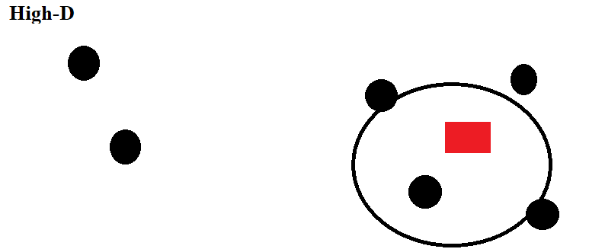

High Dimension
$$P_{ij}=\frac{\exp\left(−\frac{{\left|\left|X_{i} −X_{j}\right|\right|}^{2}}{2σ^{2}}\right)}{\sum_{k}^{ }{\sum_{i≠k}{\exp\left(−\frac{{\left|\left|X_{k}−X_{i}\right|\right|}^{2}}{2σ^{2}}\right)}}}$$

Slide 38
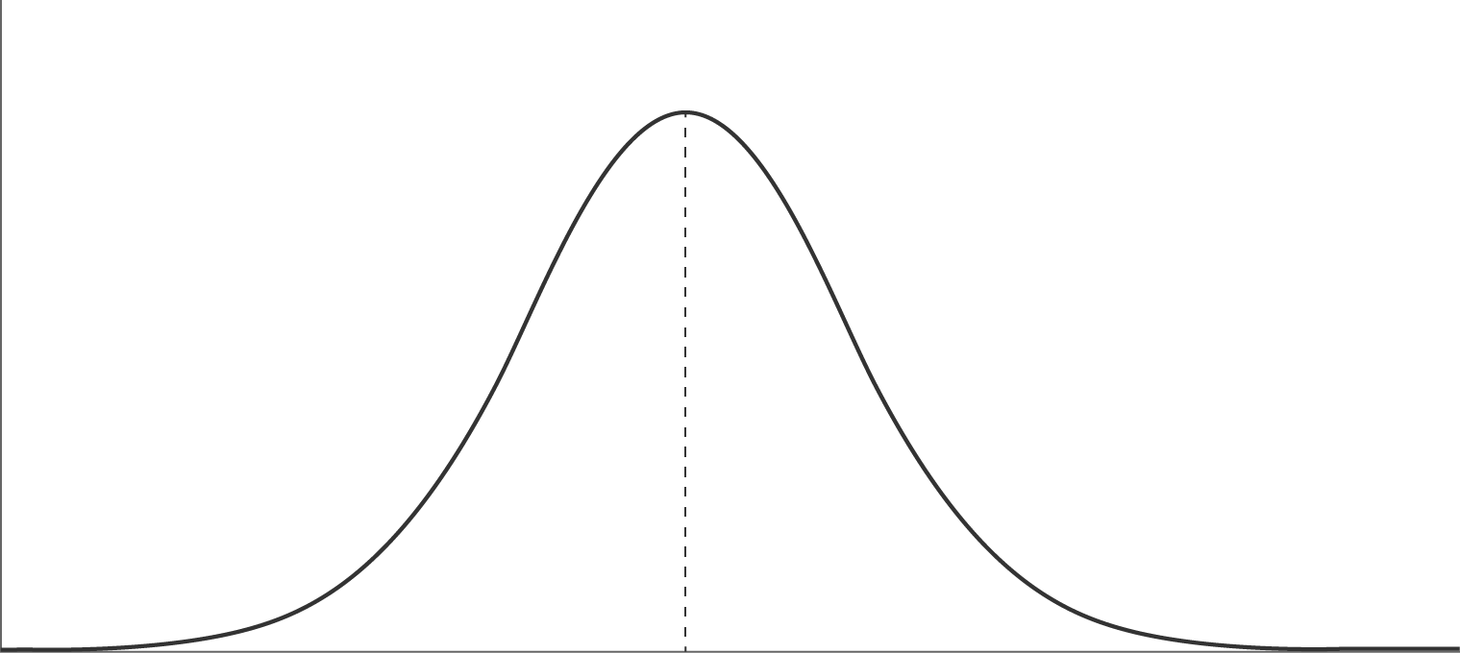
Gaussian distribution

Slide 39
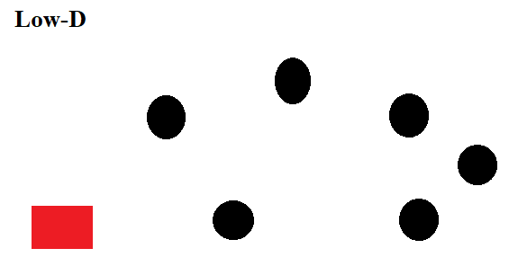

Low Dimension
$$q_{ij}=\frac{{\left(1+{\left|\left|y_{i} −y_{j}\right|\right|}^{2}\right)}^{−1}}{\sum_{k}{\sum_{l≠k}{{\left(1+{\left|\left|y_{k} −y_{l}\right|\right|}^{2}\right)}^{−1}}}}$$

Slide 40
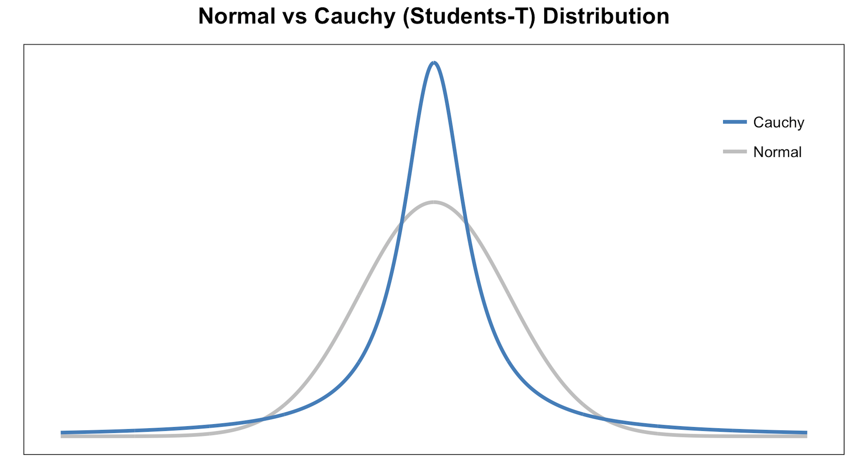
Student-t distribution
The student-t distribution with one degree of freedom is a distribution that has a heavier tilt than the Gaussian distribution. So more variation.

Slide 41
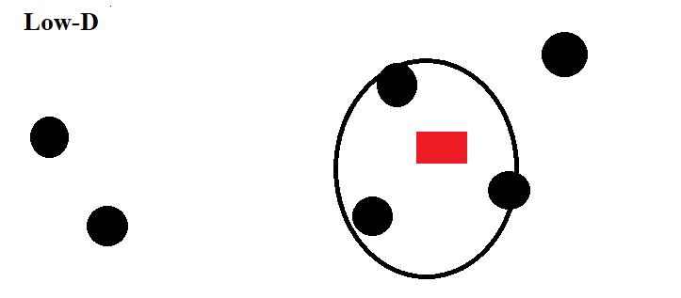

Low Dimension with Modification
$$C= KL(P|\left|Q\right)= \sum_{K}{\sum_{l≠k}{P_{ij} log⁡(\frac{P_{ij}}{q_{ij}})}}$$
Notes:
Large pij modeled by small qij : Large penalty
Small pij modeled by large qij : Small penalty
t-SNE mainly preserves local similarity structure of the data

Slide 42

Gradient Interpretation
$$\frac{∂C}{∂y_{i}}=4\sum_{j≠i}{\left(P_{ij} −q_{ij}\right){\left(1+{\left|\left|y_{i} −y_{j}\right|\right|}^{2}\right)}^{−1}(y_{i} −y_{j})}$$
Exertion / Compression
Displacement
(Spring)
Note:
We can interpret the t-SNE gradient as a simulation of an N-body system.

Slide 43
Displacement
Exertion / Compression
Summation
$$\frac{∂C}{∂y_{i}}=4\sum_{j≠i}{\left(P_{ij} −q_{ij}\right){\left(1+{\left|\left|y_{i} −y_{j}\right|\right|}^{2}\right)}^{−1}(y_{i} −y_{j})}$$

Slide 44
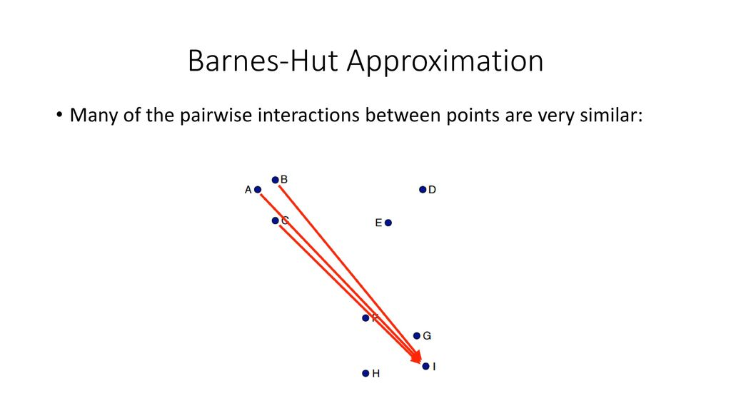
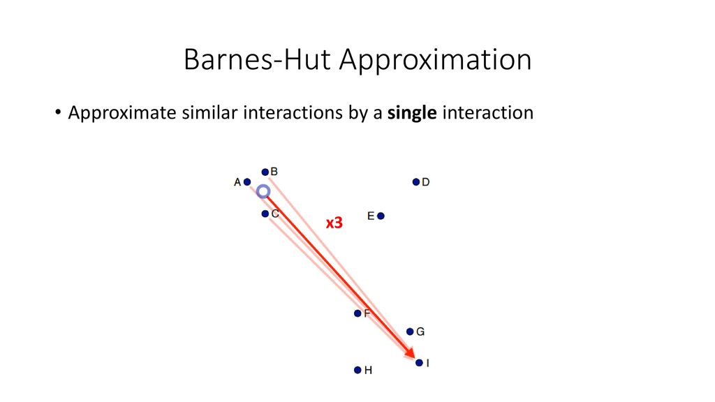
Barnes-Hut Approximation
Many of the pairwise interactions between points are very similar
Approximate similar interactions by a single interaction

Slide 45
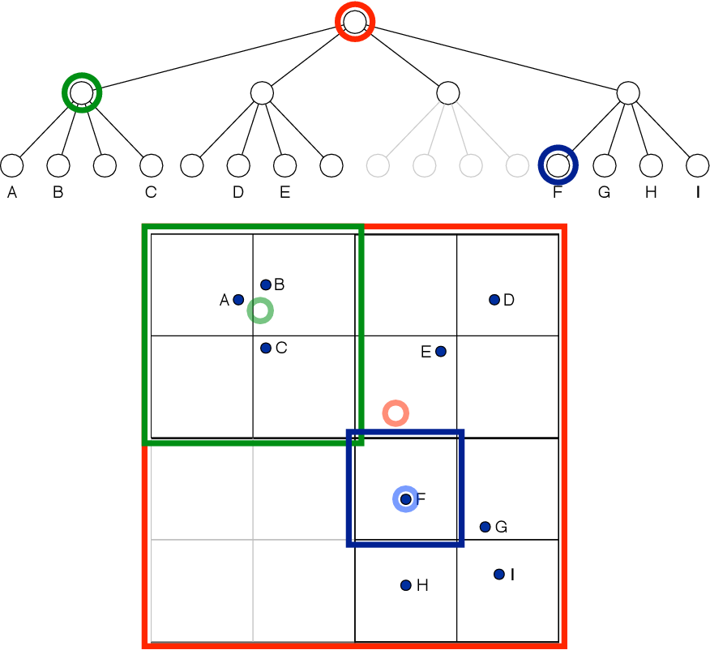
Quadtree
Note:
Quadtree is a space partitioning tree.

Slide 46
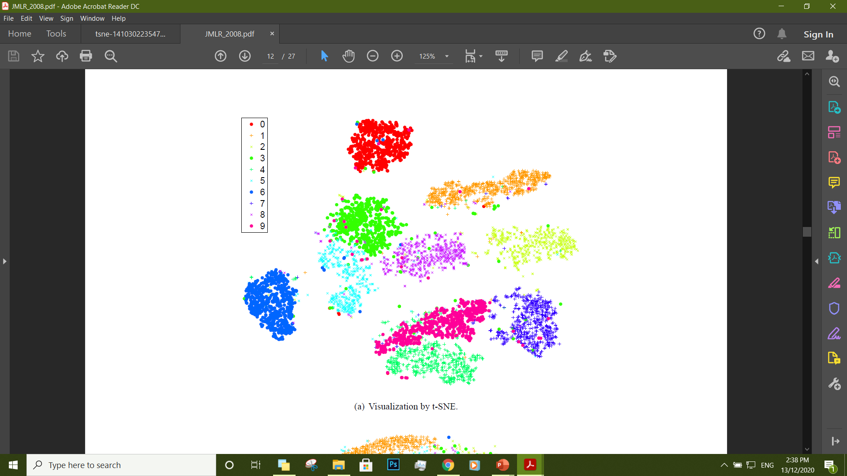
t-SNE Visualization on MNIST Data

Slide 47
K-means Clustering Algorithm

Slide 48
Topics
Motivation
Supervised vs Unsupervised Learning
What is Clustering?
K-means Objective
K-means Algorithm
Choosing the Appropriate Number of Clusters
How to Apply? – Source Code

Slide 49
Motivation
The k-means clustering method is an unsupervised machine learning technique used to identify clusters of data objects in a dataset

Slide 50
Motivation
K-NN
K-means
Used in statistics and It is a non-parametric machine learning method and kind of supervised machine learning
It is used for classification and regression
Method of vector quantization, originally from signal processing, that aims to partition (n) observations into (k) clusters in which each observation belongs to the cluster with the nearest mean (cluster centers or cluster centroid)

Slide 51
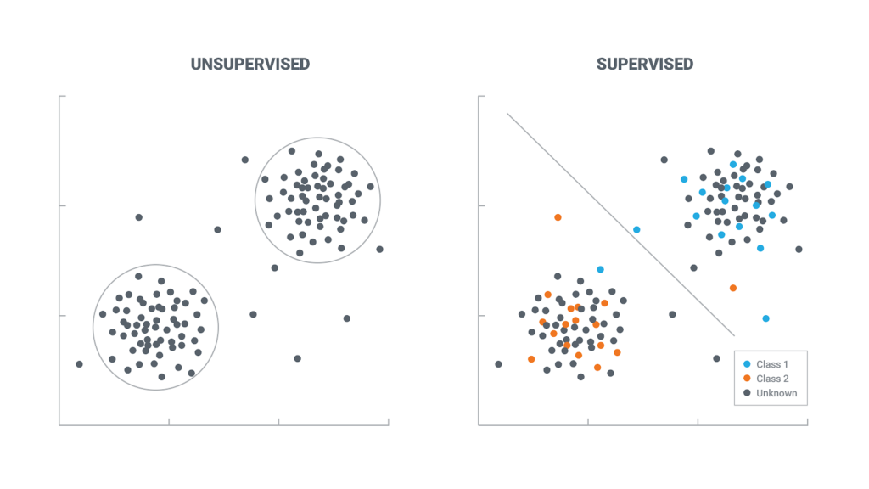
Supervised vs Unsupervised Learning
Notes:
Supervised Learning: is where you have input (x) and an corresponding output (y)
Unsupervised Learning: is where you have input (x) and no corresponding output

Slide 52
What is Clustering?
Clustering is a set of techniques used to partition data into groups, or clusters
Partitional Clustering
Hierarchical Clustering
Density-based Clustering
Notes:
Partitional clustering divides data objects into non-overlapping groups.
Hierarchical clustering determines cluster assignments by building a hierarchy. This is implemented by either a bottom-up or a top-down approach:
Density-based clustering determines cluster assignments based on the density of data points in a region. Clusters are assigned where there are high densities of data points separated by low-density regions.

Slide 53
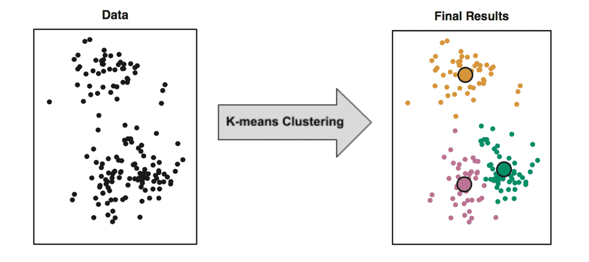
K-means Objective

Slide 54
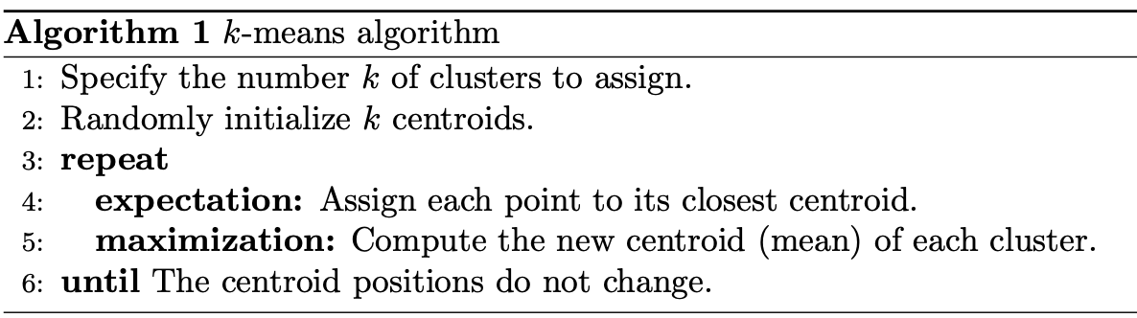
K-means Algorithm

Slide 55
K-means Algorithm

Slide 56
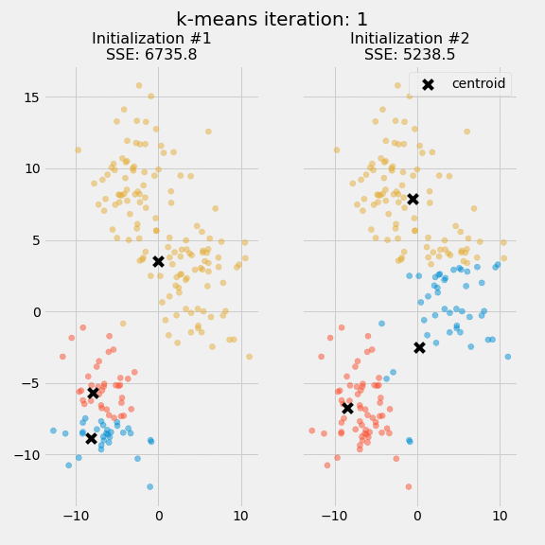
K-means Algorithm
The quality of the cluster assignments is determined by computing the sum of the squared error (SSE) after the centroids converge

Slide 57
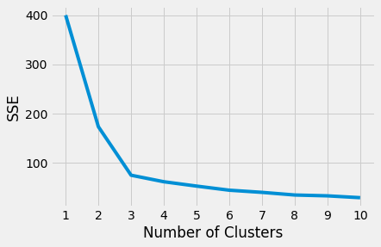
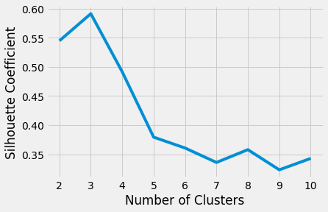
Choosing the Appropriate Number of Clusters
The elbow method
The silhouette coefficient

Slide 58
How to Apply? – Source Code
Using sklearn library in Python
GP Example:
from sklearn.cluster import Kmeans
from sklearn.metrics import silhouette_score
kmeans = KMeans(n_clusters = 3, random_state = 0).fit(tsne3)
kmeans_tsne3 = kmeans.fit_transform(tsne3)

Slide 59
PCA Result with Different Numbers of Components (Two, Three and Five)

Slide 60

Two
Three
Five
Notes:
Notes to presenter:
What was important about this learning experience?
How is it relevant to your course, yourself, or your society or community?
Why is this significant?
This SmartArt allows you add images and text to help outline your process. If a picture is worth a thousand words, then pictures and words should help you communicate this reflection on learning perfectly! You can always click on Insert>SmartArt to change this graphic or select the graphic and click on the Design contextual menu to change the colors.

Slide 61
t-SNE Result with Different Numbers of Components (Two and Three only)

Slide 62
Two
Three
Five
Notes:
Notes to presenter:
What was important about this learning experience?
How is it relevant to your course, yourself, or your society or community?
Why is this significant?
This SmartArt allows you add images and text to help outline your process. If a picture is worth a thousand words, then pictures and words should help you communicate this reflection on learning perfectly! You can always click on Insert>SmartArt to change this graphic or select the graphic and click on the Design contextual menu to change the colors.

Slide 63
CONCLUSION

